Slide 1

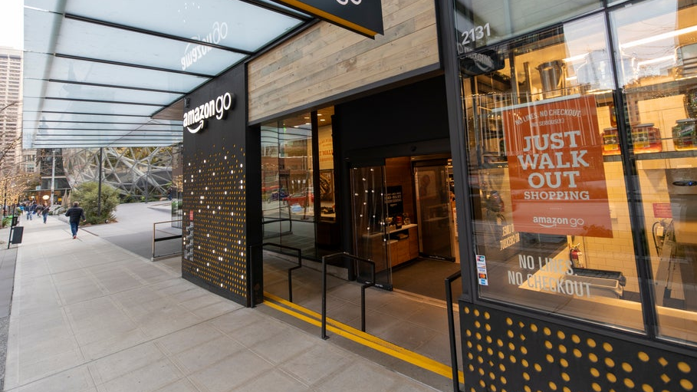
Just Walk Out Technology
Carolina Aldana
Machine Learning

Slide 2

Content
I. Business Application
II. Data Set Characteristics
III. Results and Offered Value

Slide 3

I. Business Application

Slide 4

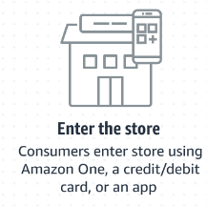


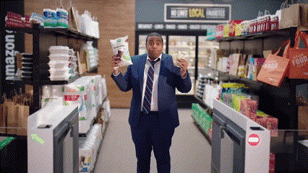
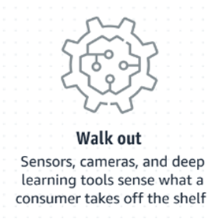
What is Just Walk Out Technology?
Just Walk Out technology is meant to enhance physical shopping experience with fast, contactless transactions.

Slide 5
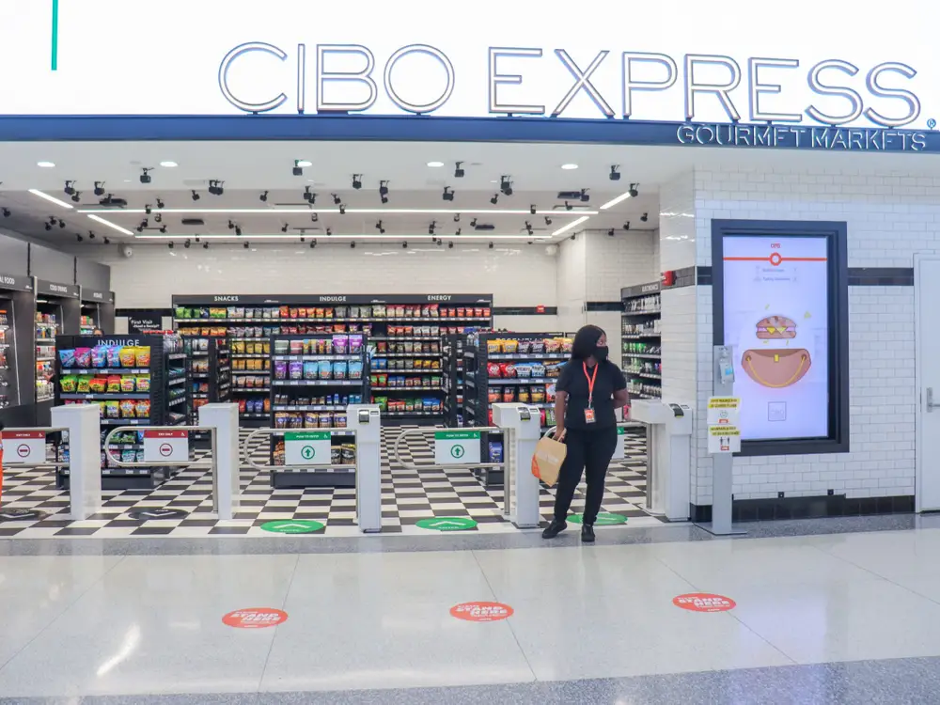
Business Application and Importance:
“There are now more than 140 third-party locations with Just Walk Out technology in the U.S., UK, Australia, and Canada. These include travel retailers, sports stadiums, entertainment venues, conference centers, theme parks, convenience stores, hospitals, and college campuses” (Amazon, 2024)

Slide 6

II. Data Set Characteristics

Slide 7
Data Sources: Store Sensors, Customer Transactions, Customer Feedback.
Data Types:
Numerical: Number of Purchases, Time Since Last Purchase, Item Count.
Categorical: Customer Satisfaction (“satisfied”," "neutral," "dissatisfied"), Payment Status (Success/Failure).
Independent Variables: Number of Purchases, Time since Last Purchase, Item Count.
Dependent Variables: Payment Status (Success/Failure), Customer Satisfaction.
Important Data Fields: Numbers, Strings.
Objective: How do Amazon’s store customers perceive the impact of Just Walk Out technology on their shopping experience?

Slide 8

III. Results and Offered Value

Slide 9

III. Results and Offered Value
A study from the book Innovations in Smart Cities Application (2024) reveals that Just Walk Out technology is appealing due to its ease of use, convenience, and sense of freedom. However, there are concerns about personal data privacy, lack of human interaction and the loss of jobs.
Offered value:
Reduces Checkout Times.
Customer Behavior Insights.
Fresh Experiences.
Improved Inventory Control.

Slide 10
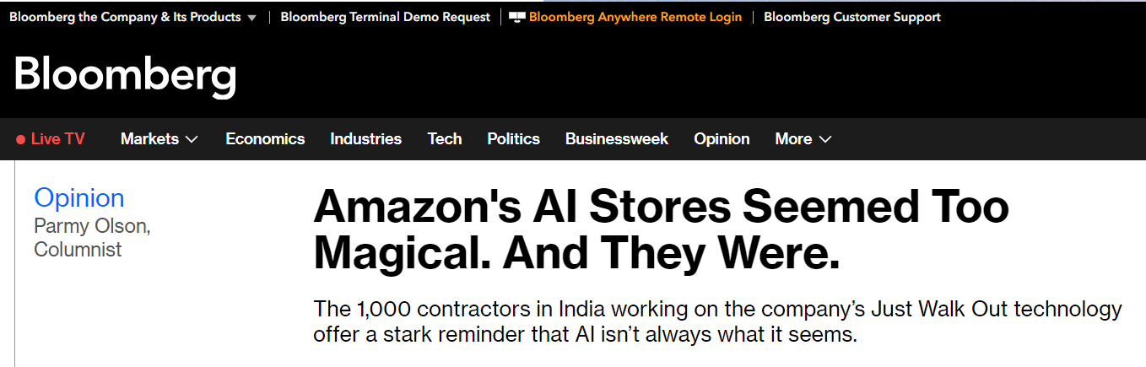
III. Results and Offered Value
Just Walk Out technology has faced accusations of being deceptive, as it was reportedly supported by a team of 1,000 workers in India. Allegedly, 700 out of every 1,000 'Just Walk Out' transactions were verified by this team.
An Amazon spokesperson stated that the India-based team only assisted in training the model used for 'Just Walk Out’ (Bloomberg, 2024)

Slide 11
References
Bentalha, B. & Hmioui, A. Innovations in Smart Cities Applications Volume 5: The Proceedings of the 6th International Conference on Smart City Applications. (2022). 393. https://doi.org/10.1007/978-3-030-94191-8
Barry, L. (2024, abril 4). Amazon shuts down its Just Walk Out program because the AI is faulty. WBBM NewsRadio. https://www.audacy.com/wbbm780/news/national/why-did-amazon-just-shut-down-its-just-walk-out-program
Consumer and Retail Group https://alvarezandmarsal-crg.com/wp-content/uploads/2022/08/Just-Walk-Out-Alvarez-and-Marsal-Consumer-Retail-Group.pdf
Herrera, A. (2024, March 1). No Lines or Registers: How Does Just Walk Out Technology Work? Fit Small Business. https://fitsmallbusiness.com/just-walk-out-technology/
Olson, https://www.bloomberg.com/opinion/articles/2024-04-03/the-humans-behind-amazon-s-just-walk-out-technology-are-all-over-ai
Kumar, D. (2024, abril 17). An update on Amazon's plans for Just Walk Out and checkout-free technology. Amazon. https://www.aboutamazon.com/news/retail/amazon-just-walk-out-dash-cart-grocery-shopping-checkout-stores

